Slide 1
IBM University Engagement Project Submission
“Exploring the Power of Agentic AI with IBM Granite and IBM Bob”

Slide 2

Project Tile – Researchx-vector-index
Domain of Project – Education
Student Name | Recent Passport Photo | Email ID | Mobile number [WhatsApp]
Shivani Pratap Jadhav |  | jadhavshivani2024@gmail.com | 7972401175
Recommended font style and size: Font Style: Arial Font Size (Heading): 28
Font Size (Content): 20

Slide 3
Problem Statement -
The Challenge
Brands, influencers, and organizations struggle to manage multiple social media platforms due to rapidly changing trends, shifting audience sentiment, and evolving competitor strategies. Fragmented data leads to missed engagement opportunities, ineffective campaigns, and delayed decision-making.
The Objective
Build an AI-powered Social Media Agent using IBM Bob, watsonx.ai, and Granite Models that provides:
Multichannel Data Integration – Analyze posts, comments, hashtags, and competitor content from X, LinkedIn, Instagram, and Facebook.
AI Content Generation – Create posts, captions, hashtags, and campaign ideas from text, image, or voice inputs.
Predictive Analytics – Forecast trending hashtags, audience sentiment, competitor activity, and optimal posting times.
Multi-Agent System
Social Media Intelligence Agent
Content Generation Agent
Trend Forecasting Agent

Slide 4
Proposed Solution -
Proposed Solution: AI-Powered Social Media Agent
The solution includes an interactive analytics dashboard (built with Streamlit or React) that provides real-time visualization of engagement metrics, hashtag performance, audience sentiment, competitor benchmarking, influencer networks, campaign performance, and trend forecasts. The dashboard also delivers AI-driven content recommendations and actionable insights through intuitive charts and visual analytics.
IBM Bob serves as the orchestration layer, coordinating the interaction between multiple AI agents and automating end-to-end workflows. IBM watsonx.ai enables scalable model deployment, vector embeddings, semantic retrieval, and enterprise-grade AI governance, while IBM Granite Models power intelligent content generation, summarization, sentiment analysis, reasoning, trend forecasting, and strategic decision support.
Overall, the proposed solution delivers an end-to-end agentic AI platform for social media intelligence, empowering brands, influencers, and organizations to generate high-quality content, monitor audience behavior, anticipate emerging trends, optimize campaign strategies, and make data-driven decisions through real-time insights and predictive analytics.

Slide 5
Technology Used
IBM Bob Platform – For designing and orchestrating multi-agent workflows visually, enabling seamless coordination between the Social Media Intelligence Agent, Content Generation Agent, Trend Forecasting Agent, and Campaign Analytics Agent.
IBM Granite Model – For natural language understanding, content generation, reasoning, sentiment analysis, trend forecasting, and personalized social media recommendations.
IBM Cloud – It provides the infrastructure to build, deploy, and scale the Social Media Agent efficiently. IBM Cloud enables a reliable, secure, and scalable environment for deploying the Social Media Agent.
RAG (Retrieval-Augmented Generation) – RAG fetches real-time social media data, trending hashtags, competitor posts, audience insights, and relevant content before generating intelligent recommendations, making the Social Media Agent more accurate, context-aware, and effective.
IBM watsonx.ai – For model deployment, embeddings, semantic retrieval, and AI governance.
Vector Database (FAISS/Chroma) – For RAG-based retrieval of social media posts, hashtags, comments, competitor content, and trend data.

Slide 6
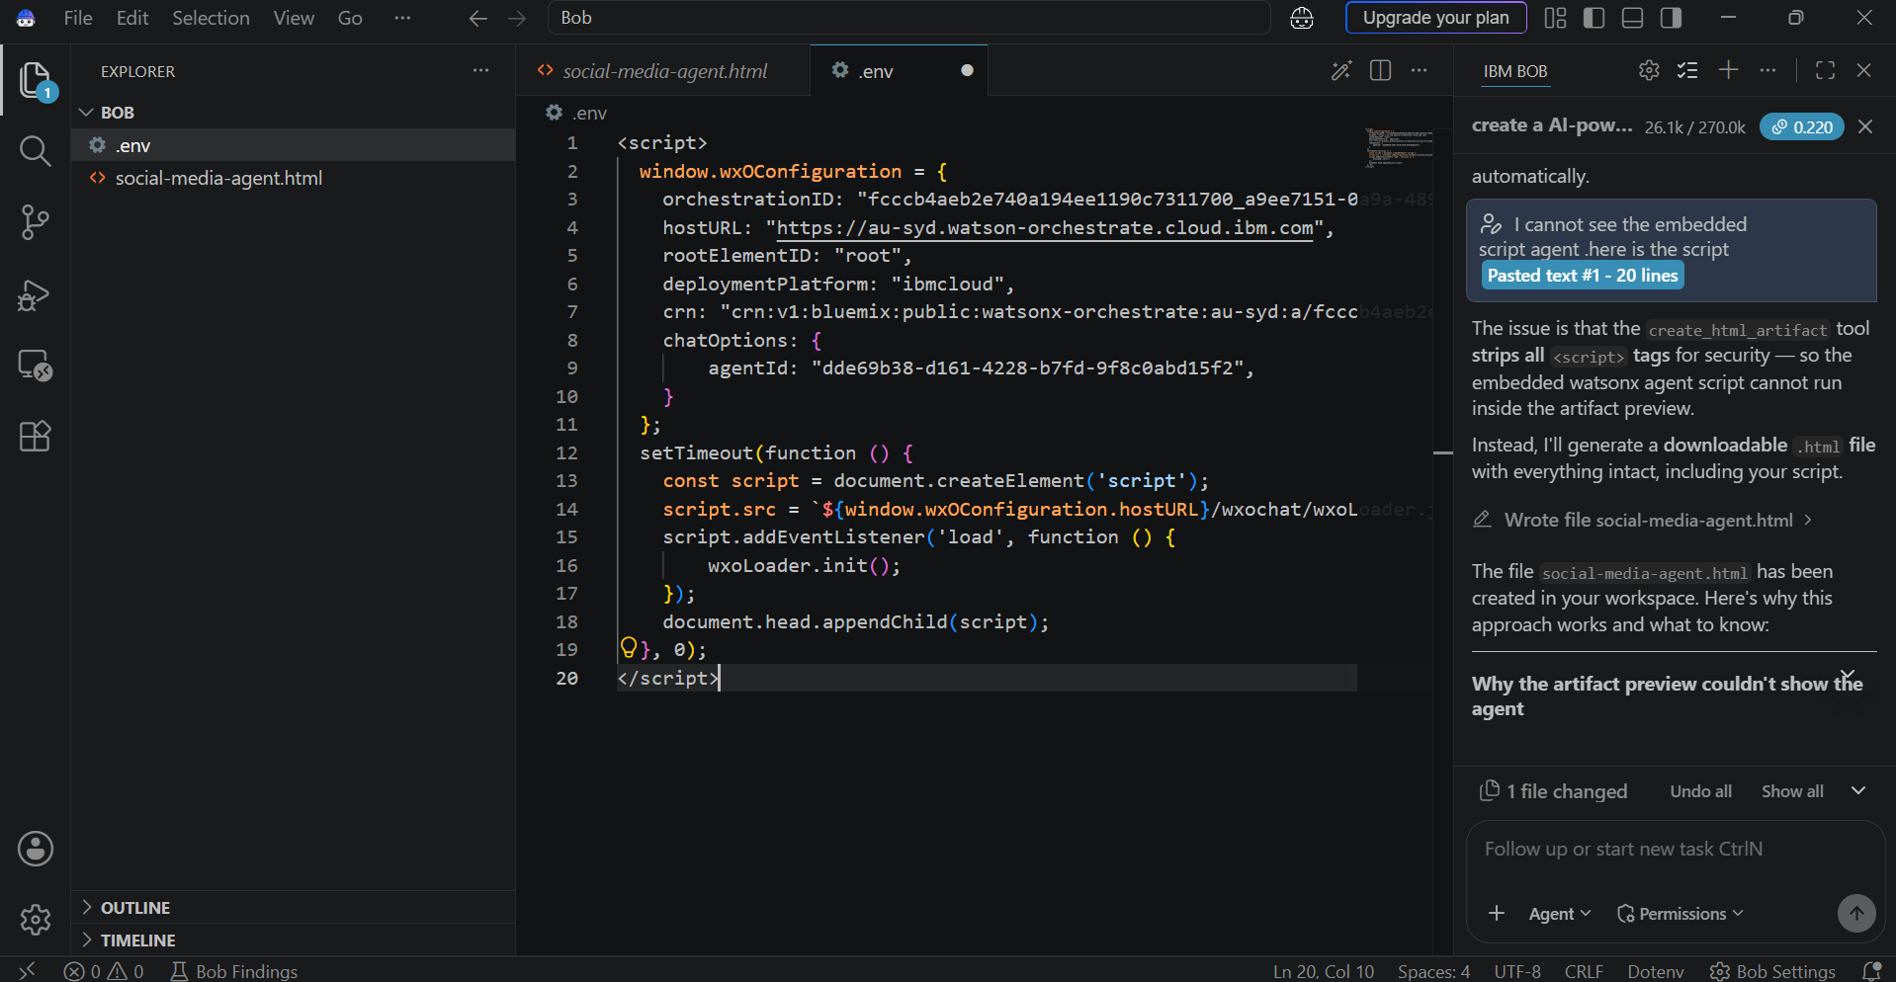
Required Files created using IBM bob -
Index.html
Style.css
3 . .env

Slide 7
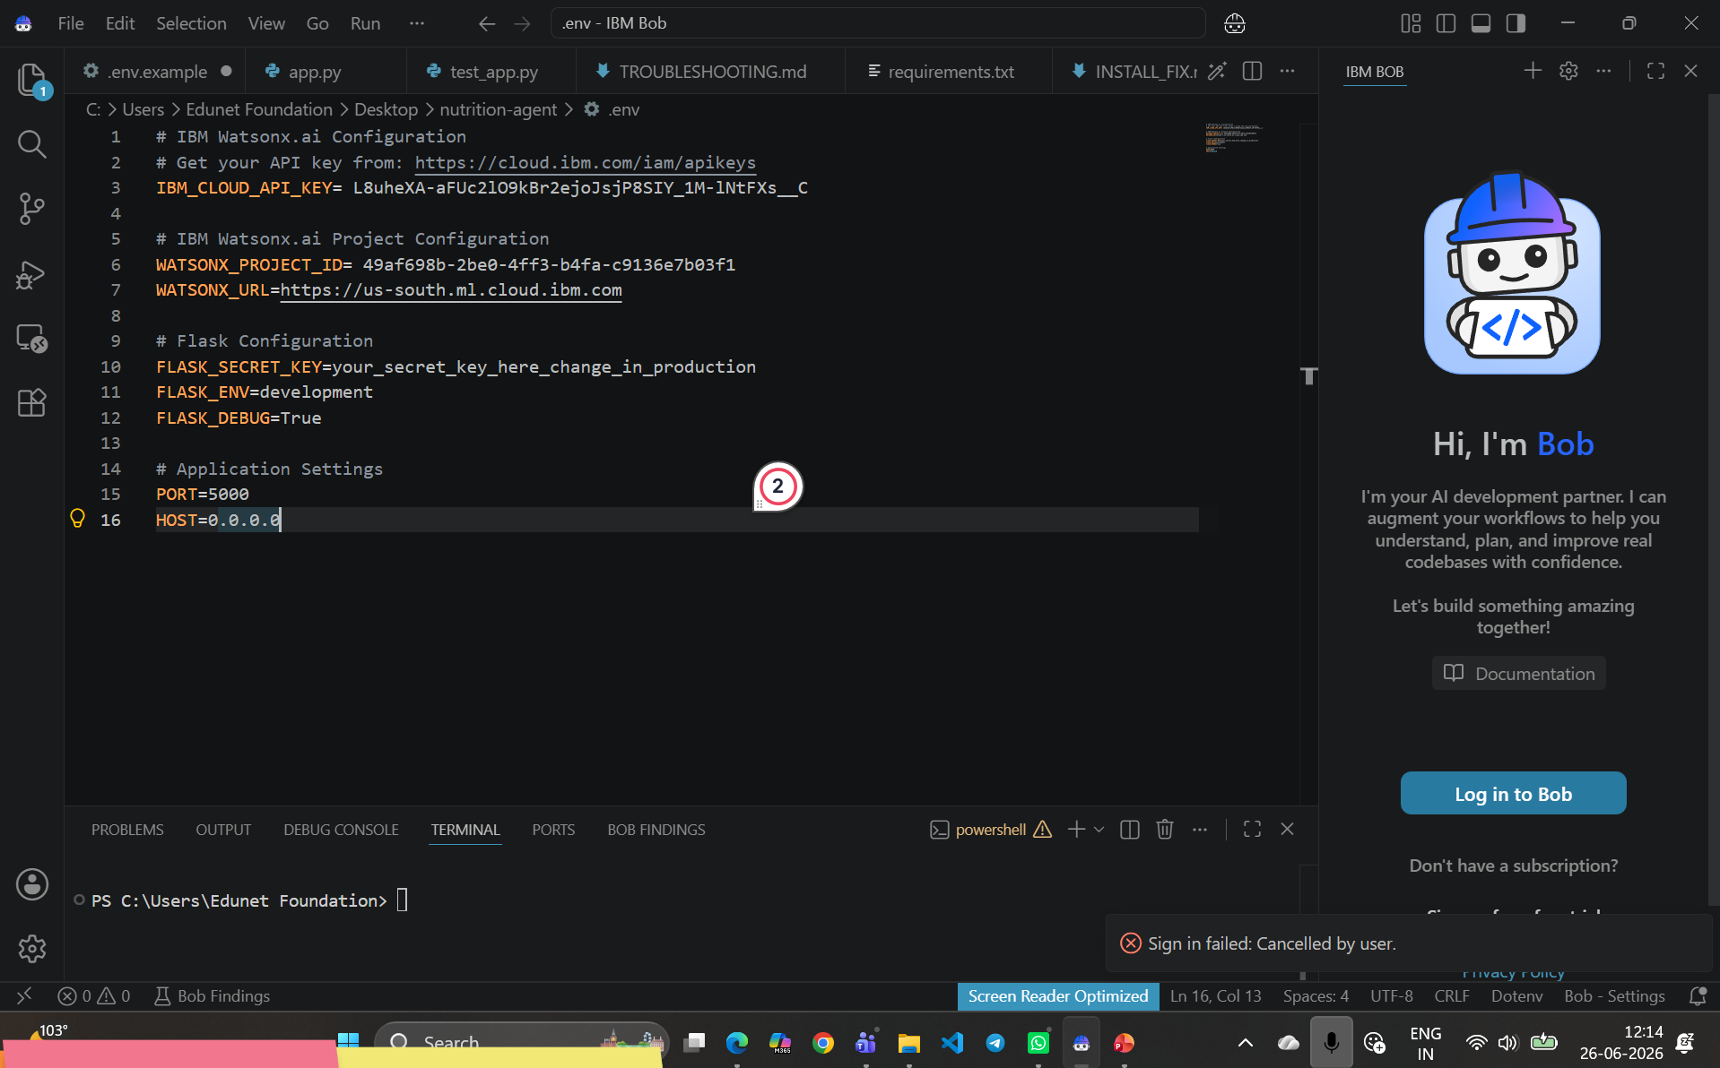
IBM Bob Screenshots:

Slide 8
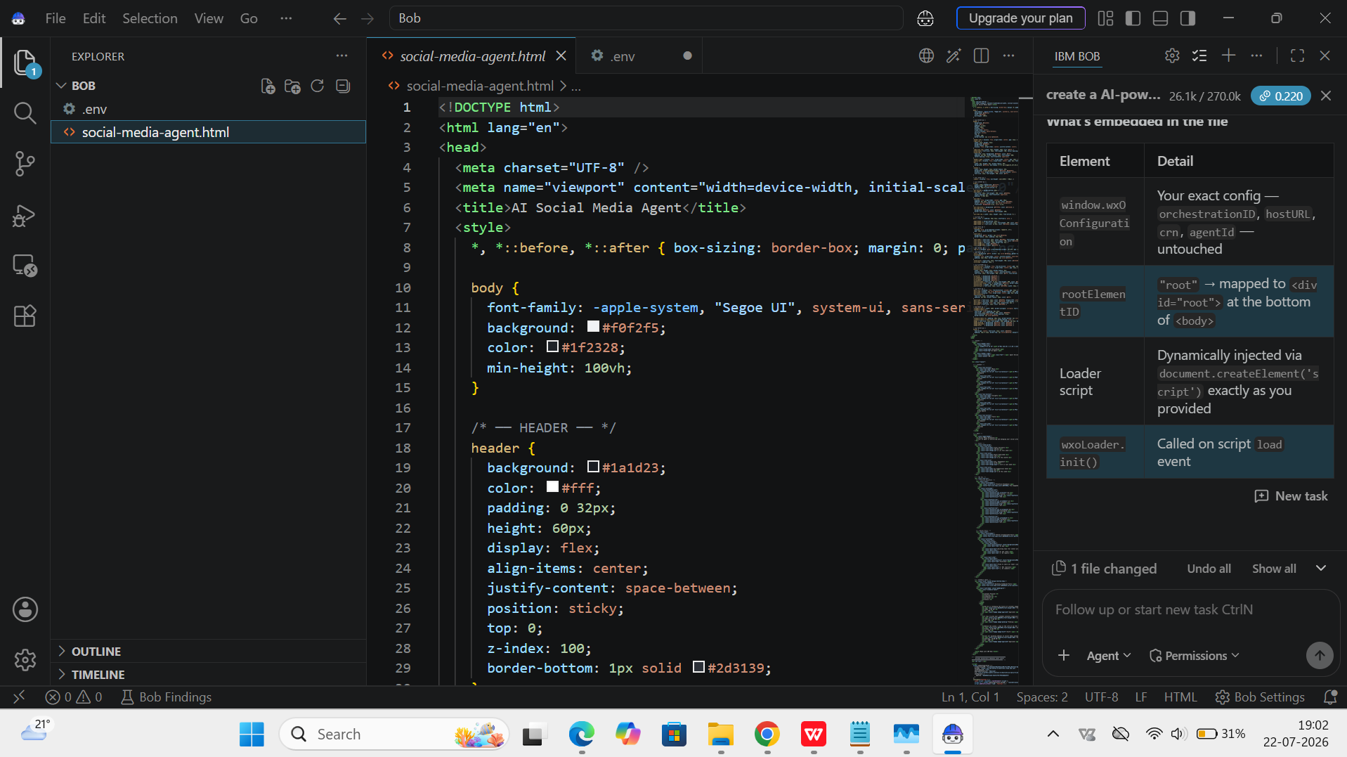

Slide 9

Role of Agentic AI in the solution
Role of Agentic AI in Social Media Agent
Agentic AI enables the Social Media Agent to operate as an intelligent, autonomous system rather than a basic content generation tool. It coordinates multiple specialized agents to analyze social media data, generate engaging content, predict trends, and monitor campaign performance. By understanding brand tone, audience preferences, and campaign goals, it delivers personalized recommendations and adapts to real-time social media trends. This collaborative multi-agent approach improves decision-making, optimizes engagement, and helps brands create effective, data-driven social media strategies.

Slide 10
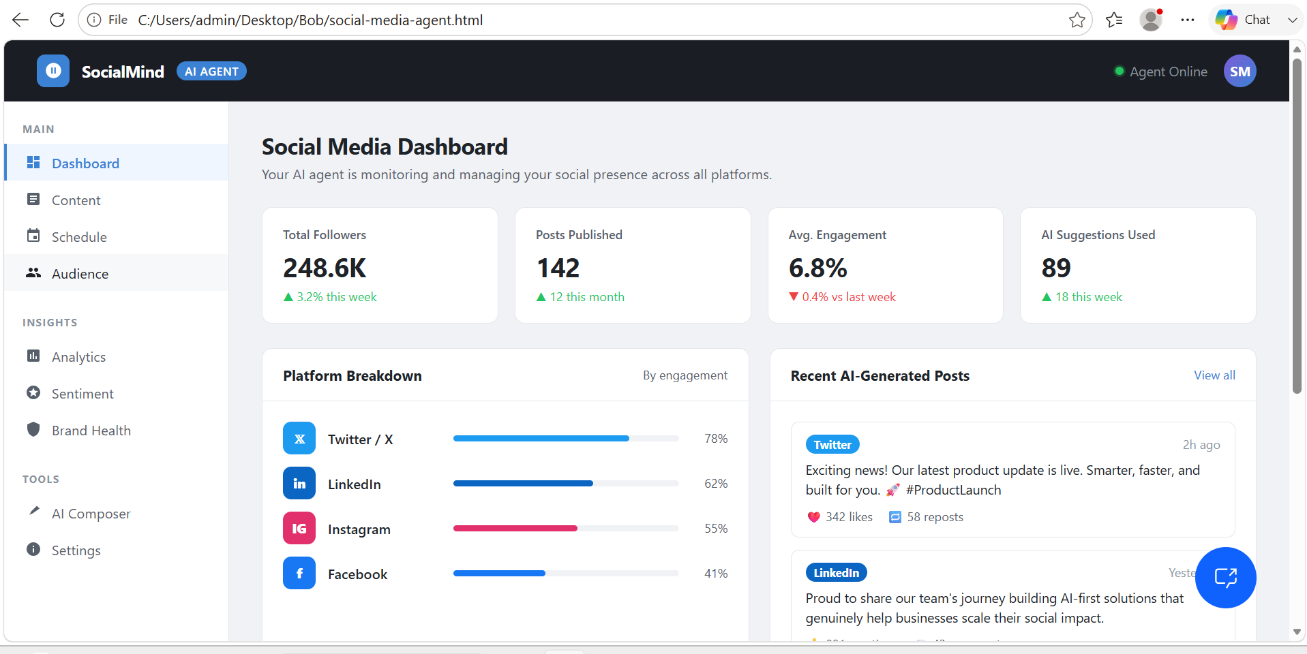
Project Output Screenshot
·
·
·

Slide 11
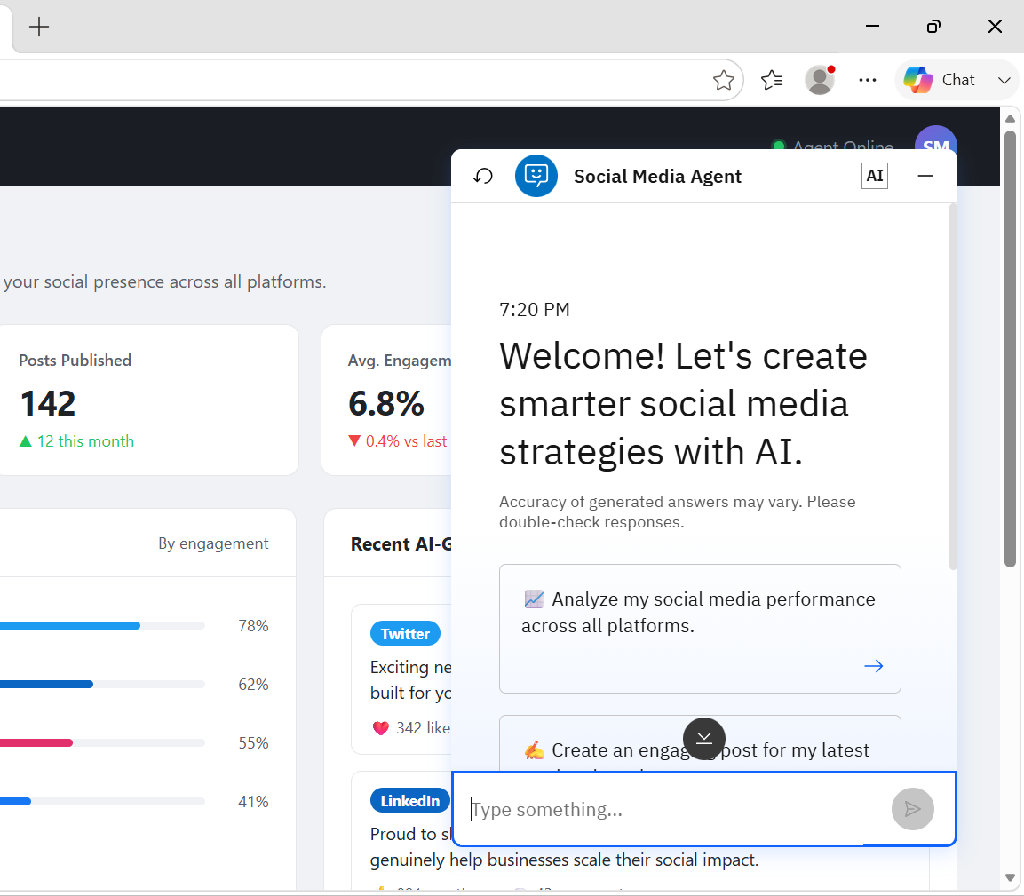
Project Output Screenshot
Please put IBM Bob output screenshots with 2-3 prompts.
You can take 2-3 more slides for each screenshot
·
·
·

Slide 12
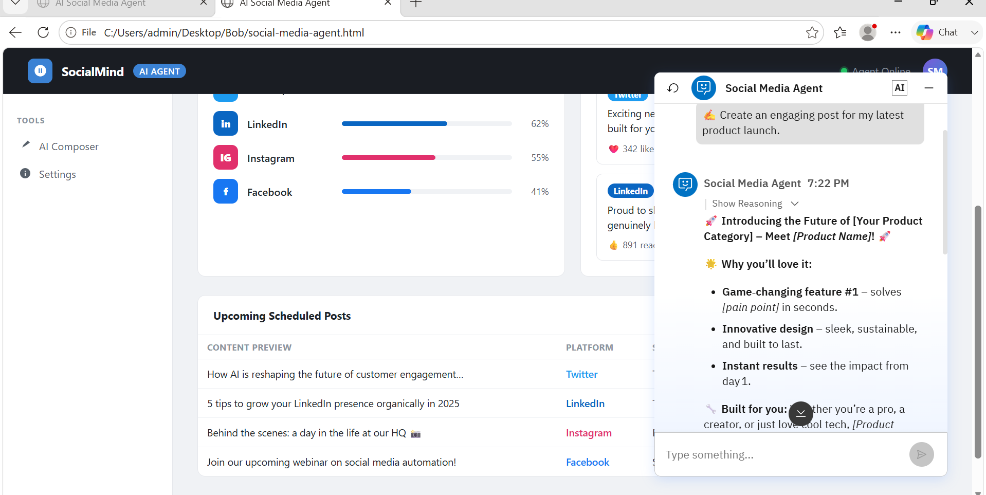
Project Output Screenshot
Please put IBM Bob output screenshots with 2-3 prompts.
You can take 2-3 more slides for each screenshot
·
·
·

Slide 13
Novelty and Uniqueness
The proposed Social Media Agent stands out by combining Agentic AI, RAG, predictive analytics, and personalization into a single intelligent platform.
Multi-Agent Intelligence – Specialized agents collaborate for content generation, trend analysis, and campaign optimization.
RAG-Based Accuracy – Retrieves real-time social media data for reliable, context-aware insights.
Personalized Content – Generates posts, captions, and hashtags aligned with brand tone and audience.
Real-Time Trend Forecasting – Predicts trending hashtags, audience sentiment, and best posting times.
Multimodal Interaction – Supports text, image, and voice inputs.
Enterprise-Ready – Built using IBM Bob, watsonx.ai, and Granite Models.
Result: An intelligent, adaptive, and proactive AI Social Media Assistant—not just a content generator.

Slide 14
Git Hub Link
Github URL – https://github.com/shivani11jadhav/AI-Social-Media-Agent/
·
·
·

Slide 15
Future Scope
1. Integration with Live Social Media APIs
The system can be integrated with official APIs of platforms such as X, LinkedIn, Instagram, and Facebook to fetch real-time posts, hashtags, audience engagement, and competitor activities. This will enable the Social Media Agent to provide more accurate insights, live trend analysis, and instant campaign recommendations.
2. AI-Powered Voice Assistant & Multilingual Support
Enhancing the system with a voice-enabled assistant and multilingual support will improve accessibility and user experience. Users will be able to create content, analyze campaigns, and receive AI-powered recommendations using voice commands in their preferred language, making the solution suitable for a global audience.
·
·
·

Slide 16
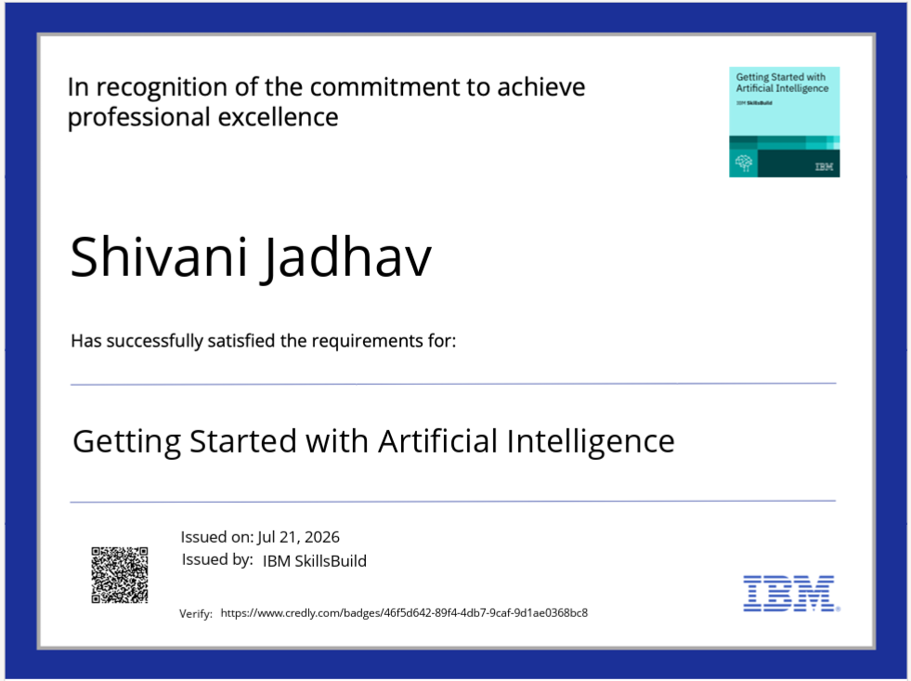
Certificates Earned:
Please add your credly certificate

Slide 17
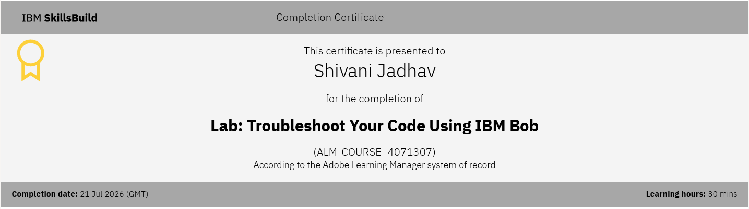
Certificates Earned:​
Add your IBM BOB Certificate

Slide 18


